Slide 1
Data Validation & Binding Exceptions
Karl Shifflett
Program Manager, Microsoft patterns & practices

Slide 2
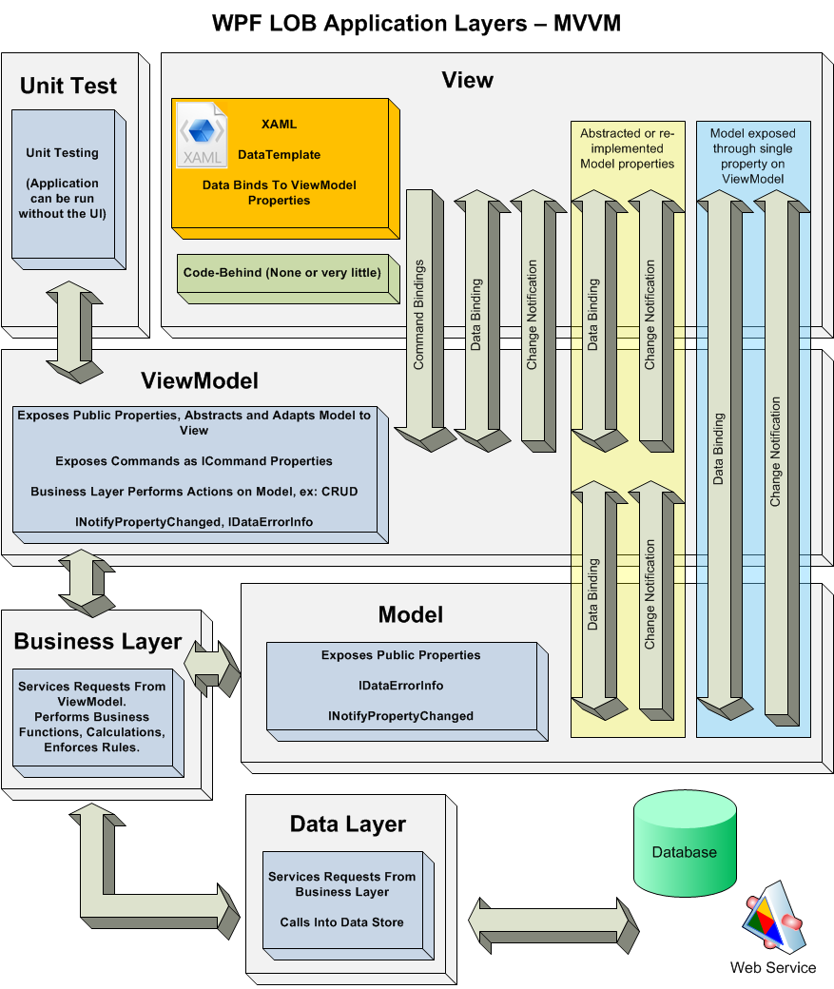
Application Validation Requirements
UI Validation
Business Layer Validation
Validation Between Tiers (e.g. server and Silverlight)
Property Level Validation
Object Level Validation
Supports Multiple Rule Sets
Note: Input validation rules and business rules are two different concepts

Slide 3
Validation Libraries
Enterprise Library Validation Application Block
CSLA – Rocky Lhotka’s Framework
Ocean – Karl Shifflett’s Framework
In House Library
Binding Validation Rules
Others

Slide 4
Validation Rule Locations
Built-in
Business object validated internally
Externally
Business object validated by passing to validator class
Rules Engine
Business object validated externally, e.g. using Work Flow
Hybrid
Combination of the above
Alternate Approach
Add validation rules directly to data binding (not recommended)

Slide 5
Reporting Validation Errors to the UI
Important: IDataErrorInfo is an interface for communicating errors, it isn’t a validation system.
System.ComponentModel.IDataErrorInfo interface
Error property
Item property
Throwing Exceptions from property setters
Supported by WPF & Silverlight
Search Internet for: fort knox business objects
Not recommended
Binding Validation Rule

Slide 6
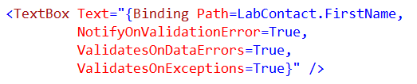
Raising Validation Errors
NotifyOnValidationError
If true, raises Validation.Error attached event
ValidatesOnDataErrors
Data binding pipeline validates UI input through the IDataErrorInfo interface
ValidatesOnExceptions
Checks for exceptions when source is updated

Slide 7
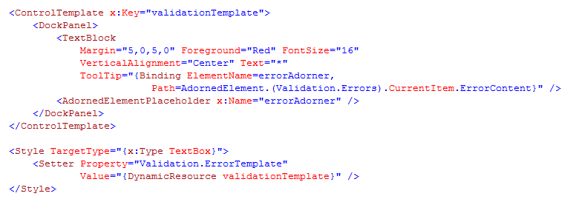
Validaton.ErrorTemplate
Use style to assign Validation.ErrorTemplate property
Valdation.ErrorTemplate is the ControlTemplate that describes the control tree for a control when the control has a validation error.

Slide 8
Demo
Validation
Data Bindings
IDataErrorInfo
Validation Error Template

Slide 9
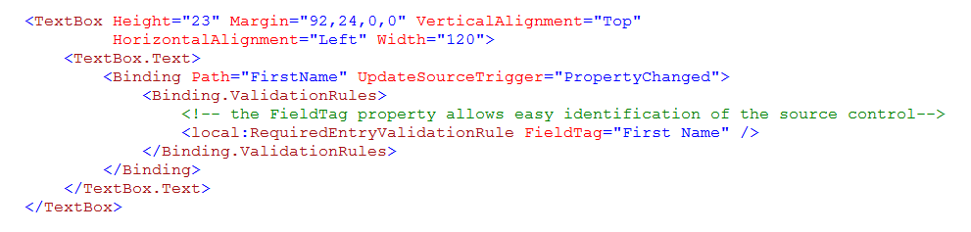
Binding Validaton Rule
Custom validation rules derive from ValidationRule
Binding engine checks each ValidationRule that is associated with a binding every time it transfers a value from the target to the source
If rule fails, sets the ErrorContent property

Slide 10
Demo
WPF Validation Rule
RequiredEntryValidationRule

Slide 11
Avoiding Binding Type Exceptions
Use advanced UI controls to prevent type mismatch exceptions (ex: DatePicker, Numeric TextBox)
Re-implement Model non-String properties on the ViewModel as Strings and handle type conversion errors as Validation Error.

Slide 12
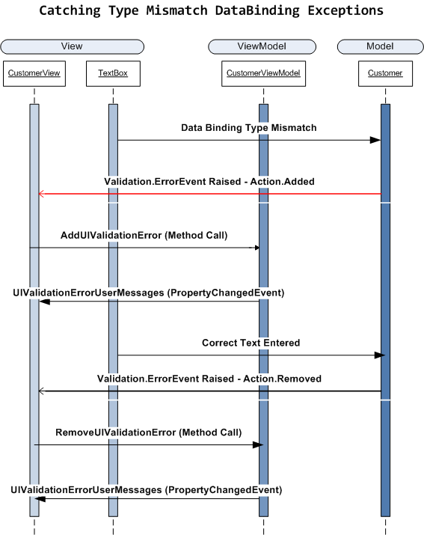
Handling UI Binding Exceptions
Validation.ErrorEvent
ErrorEvent data pushed to ViewModel or ViewModel base class

Slide 13
Demo
Validation – Binding Type Exceptions
View base class
ViewModel base class

Slide 14
Demo
Stuff – Custom Validation Framework
BusinessEntityBase – uses Data Annotations

Slide 15
Contact
Twitter: @kdawg02
Blogs
http://karlshifflett.wordpress.com/
http://blogs.msdn.com/b/kashiffl/
http://blogs.msdn.com/b/wpfsldesigner/
Links
http://compositewpf.codeplex.com/
http://msdn.microsoft.com/en-us/practices/default.aspx

Slide 16


